Slide 1


Big Data Infrastructure
CS 489/698 Big Data Infrastructure (Winter 2016)
Week 3: From MapReduce to Spark (1/2)
January 19, 2016
Jimmy Lin
David R. Cheriton School of Computer Science
University of Waterloo
These slides are available at http://lintool.github.io/bigdata-2016w/
This work is licensed under a Creative Commons Attribution-Noncommercial-Share Alike 3.0 United States See http://creativecommons.org/licenses/by-nc-sa/3.0/us/ for details

Slide 2

The datacenter is the computer!
What’s the instruction set?
Source: Google

Slide 3

So you like programming in assembly?
Source: Wikipedia (ENIAC)

Slide 4

Hadoop is great, but it’s really waaaaay too low level!
(circa 2007)
Source: Wikipedia (DeLorean time machine)

Slide 5
What’s the solution?
Design a higher-level language
Write a compiler

Slide 6




Hadoop is great, but it’s really waaaaay too low level!
(circa 2007)
What we really need is a scripting language!
What we really need is SQL!
Answer:
Answer:

Slide 7
SQL
Pig Scripts
Aside: Why not just use a database?
map
map
map
map
map
map
…
map
map
…
map
…
map
map
…
map
map
map
…
map
map
map
…
map
reduce
reduce
reduce
map
map
…
map
reduce
reduce
reduce
map
map
…
map
…
reduce
reduce
…
reduce
…
reduce
reduce
…
reduce
reduce
reduce
…
reduce
reduce
reduce
…
reduce
reduce
reduce
…
reduce
reduce
reduce
…
reduce
Both open-source projects today!

Slide 8

Story for another day….
Jeff Hammerbacher, Information Platforms and the Rise of the Data Scientist. In, Beautiful Data, O’Reilly, 2009.
“On the first day of logging the Facebook clickstream, more than 400 gigabytes of data was collected. The load, index, and aggregation processes for this data set really taxed the Oracle data warehouse. Even after significant tuning, we were unable to aggregate a day of clickstream data in less than 24 hours.”

Slide 9
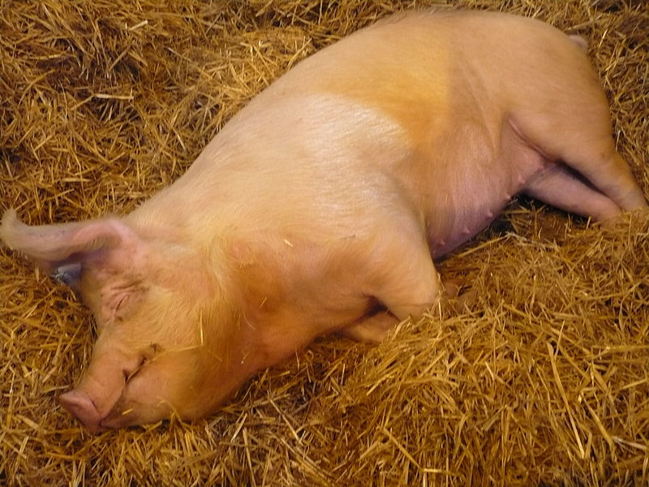
Pig!
Source: Wikipedia (Pig)

Slide 10
Pig: Example
Task: Find the top 10 most visited pages in each category
Visits
URL Info
User | Url | Time
Amy | cnn.com | 8:00
Amy | bbc.com | 10:00
Amy | flickr.com | 10:05
Fred | cnn.com | 12:00
Url | Category | PageRank
cnn.com | News | 0.9
bbc.com | News | 0.8
flickr.com | Photos | 0.7
espn.com | Sports | 0.9
Pig Slides adapted from Olston et al. (SIGMOD 2008)

Slide 11
Pig: Example Script
visits = load ‘/data/visits’ as (user, url, time);
gVisits = group visits by url;
visitCounts = foreach gVisits generate url, count(visits);
urlInfo = load ‘/data/urlInfo’ as (url, category, pRank);
visitCounts = join visitCounts by url, urlInfo by url;
gCategories = group visitCounts by category;
topUrls = foreach gCategories generate top(visitCounts,10);
store topUrls into ‘/data/topUrls’;
Pig Slides adapted from Olston et al. (SIGMOD 2008)

Slide 12
Pig Query Plan
load visits
group by url
foreach url
generate count
load urlInfo
join on url
group by category
foreach category
generate top(urls, 10)
Pig Slides adapted from Olston et al. (SIGMOD 2008)

Slide 13
MapReduce Execution
Map₁
load visits
group by url
Reduce₁
Map₂
foreach url
generate count
load urlInfo
join on url
Reduce₂
Map₃
group by category
Reduce₃
foreach category
generate top(urls, 10)
Pig Slides adapted from Olston et al. (SIGMOD 2008)

Slide 14
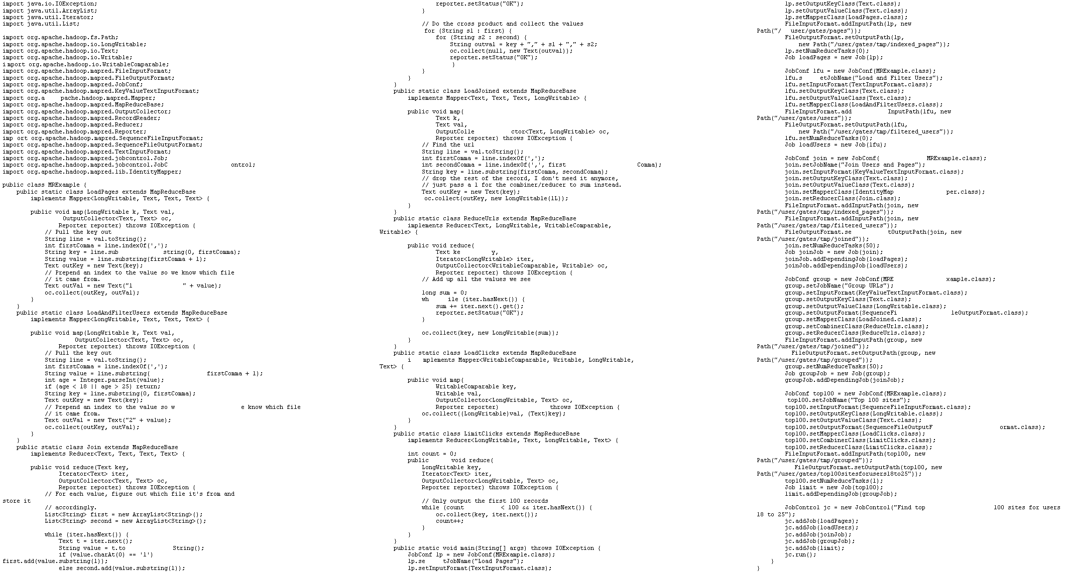
visits = load ‘/data/visits’ as (user, url, time);
gVisits = group visits by url;
visitCounts = foreach gVisits generate url, count(visits);
urlInfo = load ‘/data/urlInfo’ as (url, category, pRank);
visitCounts = join visitCounts by url, urlInfo by url;
gCategories = group visitCounts by category;
topUrls = foreach gCategories generate top(visitCounts,10);
store topUrls into ‘/data/topUrls’;
This?
Or this?

Slide 15
But isn’t Pig slower?
Sure, but c can be slower than assembly too…

Slide 16
Pig: Basics
Sequence of statements manipulating relations (aliases)
Data model
atoms
tuples
bags
maps
json

Slide 17
Pig: Common Operations
LOAD: load data (from HDFS)
FOREACH … GENERATE: per tuple processing
FILTER: discard unwanted tuples
GROUP/COGROUP: group tuples
JOIN: relational join
STORE: store data (to HDFS)
“map”
“reduce”

Slide 18
Pig: GROUPing
A = LOAD 'myfile.txt’ AS (f1: int, f2: int, f3: int);
(1, 2, 3)
(4, 2, 1)
(8, 3, 4)
(4, 3, 3)
(7, 2, 5)
(8, 4, 3)
X = GROUP A BY f1;
(1, {(1, 2, 3)})
(4, {(4, 2, 1), (4, 3, 3)})
(7, {(7, 2, 5)})
(8, {(8, 3, 4), (8, 4, 3)})

Slide 19
Pig: COGROUPing
A:
(1, 2, 3)
(4, 2, 1)
(8, 3, 4)
(4, 3, 3)
(7, 2, 5)
(8, 4, 3)
B:
(2, 4)
(8, 9)
(1, 3)
(2, 7)
(2, 9)
(4, 6)
(4, 9)
X = COGROUP A BY $0, B BY $0;
(1, {(1, 2, 3)}, {(1, 3)})
(2, {}, {(2, 4), (2, 7), (2, 9)})
(4, {(4, 2, 1), (4, 3, 3)}, {(4, 6),(4, 9)})
(7, {(7, 2, 5)}, {})
(8, {(8, 3, 4), (8, 4, 3)}, {(8, 9)})

Slide 20
Pig: JOINing
A:
(1, 2, 3)
(4, 2, 1)
(8, 3, 4)
(4, 3, 3)
(7, 2, 5)
(8, 4, 3)
B:
(2, 4)
(8, 9)
(1, 3)
(2, 7)
(2, 9)
(4, 6)
(4, 9)
X = JOIN A BY $0, B BY $0;
(1,2,3,1,3)
(4,2,1,4,6)
(4,3,3,4,6)
(4,2,1,4,9)
(4,3,3,4,9)
(8,3,4,8,9)
(8,4,3,8,9)

Slide 21
Pig UDFs
User-defined functions:
Java
Python
JavaScript
Ruby
…
UDFs make Pig arbitrarily extensible
Express “core” computations in UDFs
Take advantage of Pig as glue code for scale-out plumbing

Slide 22
The datacenter is the computer!
What’s the instruction set?
Okay, let’s fix this!
Source: Google

Slide 23
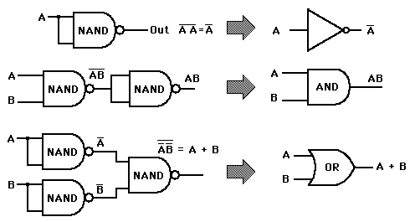
Analogy: NAND Gates are universal

Slide 24
Let’s design a data processing language “from scratch”!
(Why is MapReduce the way it is?)

Slide 25
Data-Parallel Dataflow Languages
We have a collection of records,
want to apply a bunch of transformations to compute some result
Assumptions: static collection,
records (not necessarily key-value pairs)

Slide 26
We need per-record processing
(note, not necessarily key-value pairs)
r₁
r₂
r₃
r₄
…
r_{n-1}
r_{n}
map
map
map
…
r’₁
r'₂
r’₃
r’₄
…
r'_{n-1}
r_{n}
Remarks: Easy to parallelize maps, record to “mapper” assignment is an implementation detail

Slide 27
Map alone isn’t enough
(If we want more than embarrassingly parallel processing)
We need a way to group partial results
Intermediate (key, value) pairs
grouping key
partial result
For each key, we can apply some computation

Slide 28
MapReduce
r₁
r₂
r₃
r₄
…
r_{n-1}
r_{n}
map
map
map
…
reduce
reduce
…
reduce
r’₁
r'₂
r’₃
r’₄
…
r'_{n-1}
r_{n}

Slide 29
MapReduce
List[(K1,V1)]
map f: (K1, V1) ⇒ List[(K2, V2)]
reduce g: (K2, Iterable[V2]) ⇒ List[(K3, V3)]
List[K2,V2])

Slide 30
MapReduce Workflows
HDFS
map
map
map
map
reduce
reduce
reduce
reduce
HDFS
HDFS
HDFS
HDFS
What’s wrong?

Slide 31
Want MM...?
HDFS
HDFS
map
map
map
map
HDFS
HDFS
HDFS
✔
✗

Slide 32
Want MRR?
HDFS
HDFS
map
map
map
reduce
reduce
reduce
reduce
HDFS
HDFS
HDFS
✔
✗

Slide 33
The datacenter is the computer!
Let’s enrich the instruction set!
Source: Google

Slide 34
Dryad: Graph Operators
Source: Isard et al. (2007) Dryad: Distributed Data-Parallel Programs from Sequential Building Blocks. EuroSys.

Slide 35
Dryad: Architecture
The Dryad system organization. The job manager (JM) consults the name server (NS) to discover the list of available computers. It maintains the job graph and schedules running vertices (V) as computers become available using the daemon (D) as a proxy. Vertices exchange data through files, TCP pipes, or shared-memory channels. The shaded bar indicates the vertices in the job that are currently running.
Source: Isard et al. (2007) Dryad: Distributed Data-Parallel Programs from Sequential Building Blocks. EuroSys.

Slide 36
Dryad: Cool Tricks
Channel: abstraction for vertex-to-vertex communication
File
TCP pipe
Shared memory
Runtime graph refinement
Size of input is not known until runtime
Automatically rewrite graph based on invariant properties
Source: Isard et al. (2007) Dryad: Distributed Data-Parallel Programs from Sequential Building Blocks. EuroSys.

Slide 37
Dryad: Sample Program
Source: Isard et al. (2007) Dryad: Distributed Data-Parallel Programs from Sequential Building Blocks. EuroSys.

Slide 38
DryadLINQ
LINQ = Language INtegrated Query
.NET constructs for combining imperative and declarative programming
Developers write in DryadLINQ
Program compiled into computations that run on Dryad
Sound familiar?
Source: Yu et al. (2008) DryadLINQ: A System for General-Purpose Distributed Data-Parallel Computing Using a High-Level Language. OSDI.

Slide 39
DryadLINQ: Word Count
PartitionedTable<LineRecord> inputTable =
PartitionedTable.Get<LineRecord>(uri);
IQueryable<string> words = inputTable.SelectMany(x => x.line.Split(' '));
IQueryable<IGrouping<string, string>> groups = words.GroupBy(x => x);
IQueryable<Pair> counts = groups.Select(x => new Pair(x.Key, x.Count()));
IQueryable<Pair> ordered = counts.OrderByDescending(x => x.Count);
IQueryable<Pair> top = ordered.Take(k);
Compare:
a = load ’file.txt' as (text: chararray);
b = foreach a generate flatten(TOKENIZE(text)) as term;
c = group b by term;
d = foreach c generate group as term, COUNT(b) as count;
store d into 'cnt';
Compare and contrast…

Slide 40
What happened to Dryad?
The Dryad system organization. The job manager (JM) consults the name server (NS) to discover the list of available computers. It maintains the job graph and schedules running vertices (V) as computers become available using the daemon (D) as a proxy. Vertices exchange data through files, TCP pipes, or shared-memory channels. The shaded bar indicates the vertices in the job that are currently running.
Source: Isard et al. (2007) Dryad: Distributed Data-Parallel Programs from Sequential Building Blocks. EuroSys.

Slide 41
Data-Parallel Dataflow Languages
We have a collection of records,
want to apply a bunch of transformations to compute some result
What are the operators?
MapReduce?
Spark?

Slide 42
Spark
Where the hype is!
Answer to “What’s beyond MapReduce?”
Brief history:
Developed at UC Berkeley AMPLab in 2009
Open-sourced in 2010
Became top-level Apache project in February 2014
Commercial support provided by DataBricks

Slide 43
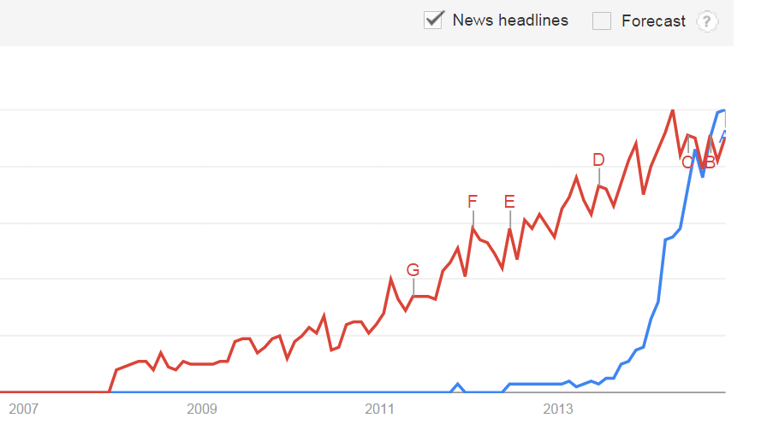
Spark Just Passed Hadoop in Popularity on the Web!
November 2014
Google Trends
Source: Datanami (2014): http://www.datanami.com/2014/11/21/spark-just-passed-hadoop-popularity-web-heres/

Slide 44
What’s an RDD?
Resilient Distributed Dataset (RDD)
Much more next session…

Slide 45
MapReduce
List[(K1,V1)]
map f: (K1, V1) ⇒ List[(K2, V2)]
reduce g: (K2, Iterable[V2]) ⇒ List[(K3, V3)]
List[K2,V2])

Slide 46
Map-like Operations
RDD[T]
RDD[T]
RDD[T]
RDD[T]
map f: (T) ⇒ U
filter f: (T) ⇒ Boolean
flatMap f: (T) ⇒ TraversableOnce[U]
mapPartitions f: (Iterator[T]) ⇒ Iterator[U]
RDD[U]
RDD[U]
RDD[U]
RDD[U]
(Not meant to be exhaustive)

Slide 47
Reduce-like Operations
RDD[(K, V)]
RDD[(K, V)]
RDD[(K, V)]
groupByKey
reduceByKey
f: (V, V) ⇒ V
aggregateByKey
seqOp: (U, V) ⇒ U, combOp: (U, U) ⇒ U
RDD[(K, Iterable[V])]
RDD[(K, V)]
RDD[(K, U)]
(Not meant to be exhaustive)

Slide 48
Sort Operations
RDD[(K, V)]
RDD[(K, V)]
sort
repartitionAnd SortWithinPartitions
RDD[(K, V)]
RDD[(K, V)]
(Not meant to be exhaustive)

Slide 49
Join-like Operations
RDD[(K, V)]
RDD[(K, W)]
RDD[(K, V)]
RDD[(K, W)]
join
cogroup
RDD[(K, (V, W))]
RDD[(K, (Iterable[V], Iterable[W]))]
(Not meant to be exhaustive)

Slide 50
Join-like Operations
RDD[(K, V)]
RDD[(K, W)]
RDD[(K, V)]
RDD[(K, W)]
leftOuterJoin
fullOuterJoin
RDD[(K, (V, Option[W]))]
RDD[(K, (Option[V], Option[W]))]
(Not meant to be exhaustive)

Slide 51
Set-ish Operations
RDD[T]
RDD[T]
RDD[T]
RDD[T]
union
intersection
RDD[T]
RDD[T]
(Not meant to be exhaustive)

Slide 52
Set-ish Operations
RDD[T]
RDD[T]
RDD[U]
distinct
cartesian
RDD[T]
RDD[(T, U)]
(Not meant to be exhaustive)

Slide 53
MapReduce in Spark?
RDD[T]
RDD[T]
map f: (T) ⇒ (K,V)
flatMap f: (T) ⇒ TO[(K,V)]
reduceByKey
f: (V, V) ⇒ V
reduceByKey
f: (V, V) ⇒ V
RDD[(K, V)]
RDD[(K, V)]
Not quite…

Slide 54
MapReduce in Spark?
RDD[T]
RDD[T]
flatMap f: (T) ⇒ TO[(K,V)]
mapPartitions f: (Iter[T]) ⇒ Iter[(K,V)]
groupByKey
groupByKey
map f: ((K, Iter[V])) ⇒ (R,S)
map f: ((K, Iter[V])) ⇒ (R,S)
RDD[(R, S)]
RDD[(R, S)]
Still not quite…

Slide 55
Spark Word Count
val textFile = sc.textFile(args.input())
textFile
.flatMap(line => tokenize(line))
.map(word => (word, 1))
.reduceByKey(_ + _)
.saveAsTextFile(args.output())
(x, y) => x + y

Slide 56
Don’t focus on Java verbosity!
val textFile = sc.textFile(args.input())
textFile
.map(object mapper {
def map(key: Long, value: Text) =
tokenize(value).foreach(word => write(word, 1))
})
.reduce(object reducer {
def reduce(key: Text, values: Iterable[Int]) = {
var sum = 0
for (value <- values) sum += value
write(key, sum)
})
.saveAsTextFile(args.output())

Slide 57
Next Time
What’s an RDD?
How does Spark actually work?
Algorithm design: redux

Slide 58

Questions?
Source: Wikipedia (Japanese rock garden)

